Slide 1
RIP & DNS & HTTP Routing
김준희

Slide 2
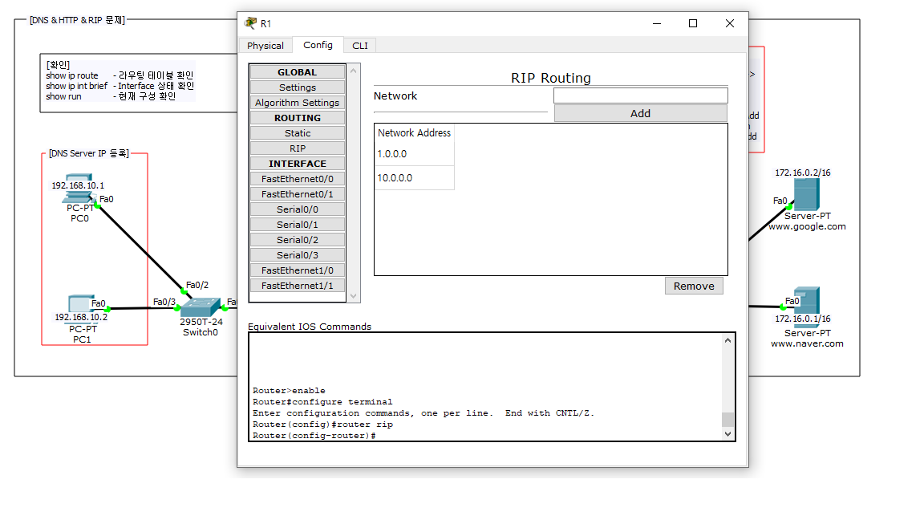
R1 RIP

Slide 3
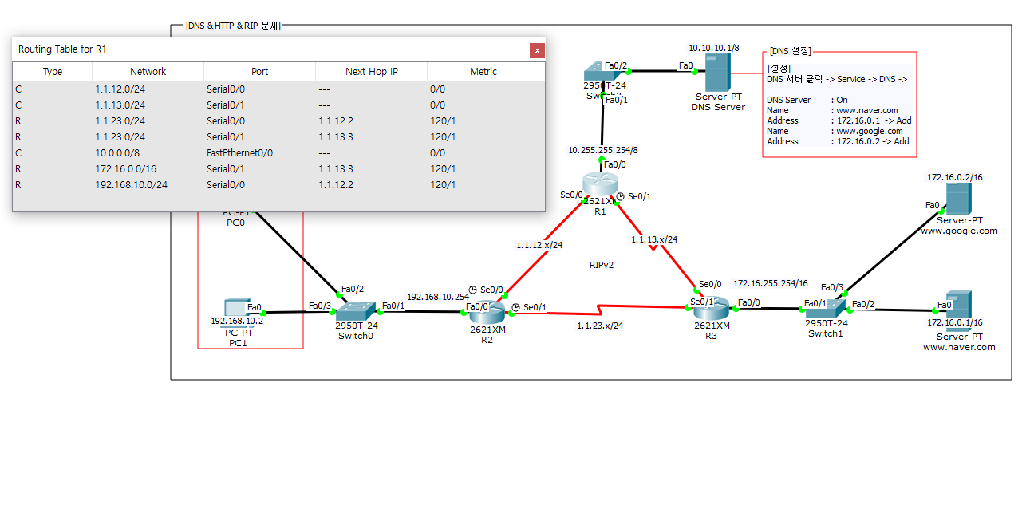
R1 Routing Table

Slide 4
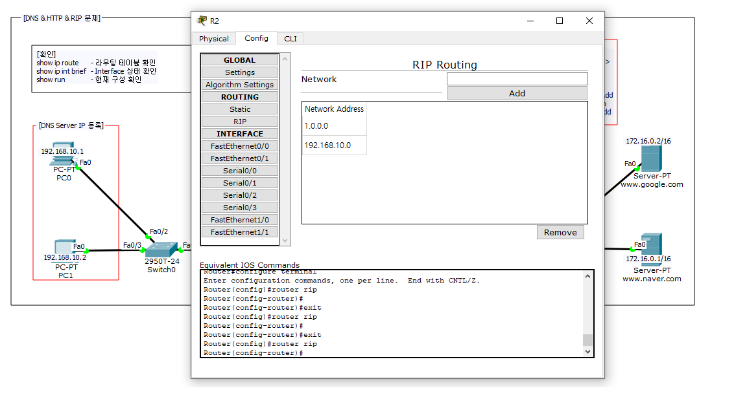
R2 RIP

Slide 5
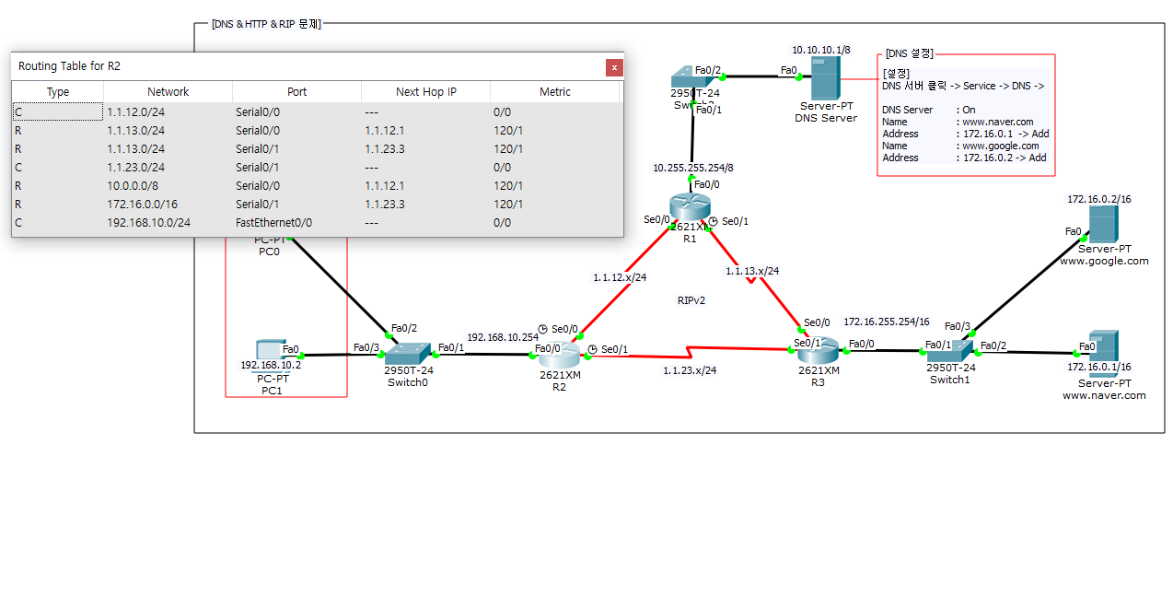
R2 Routing Table

Slide 6

R3 RIP

Slide 7

R3 Routing Table

Slide 8
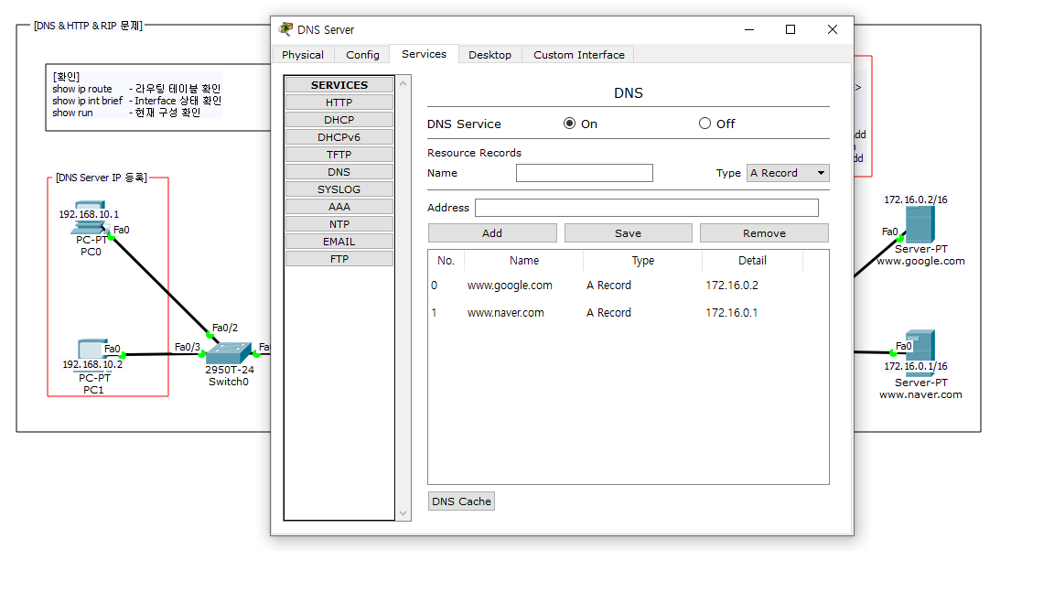
DNS Server

Slide 9
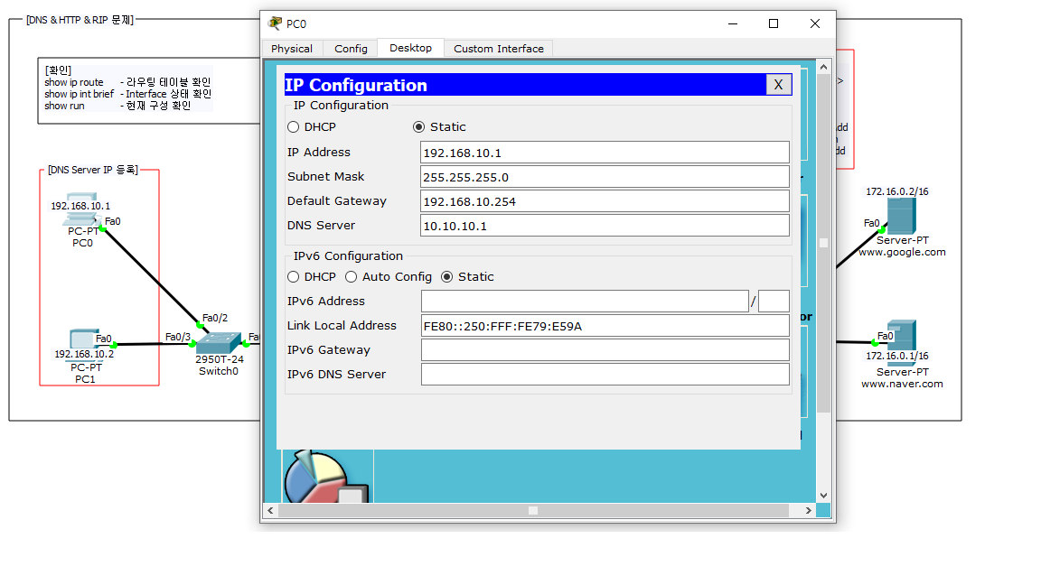
PC0 IP

Slide 10
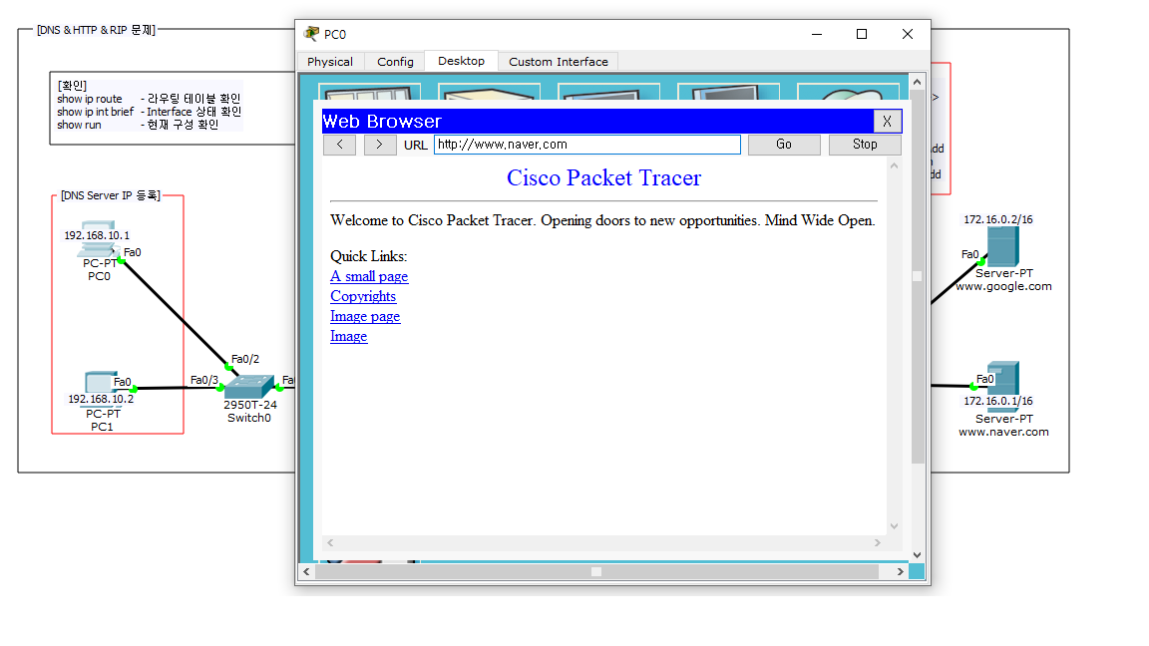
PC0 DNS

Slide 11
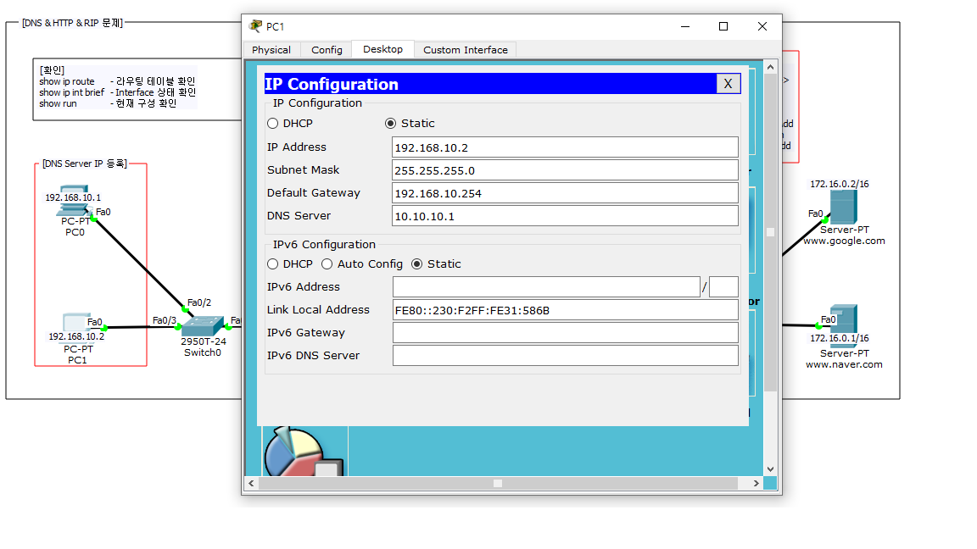
PC1 IP

Slide 12
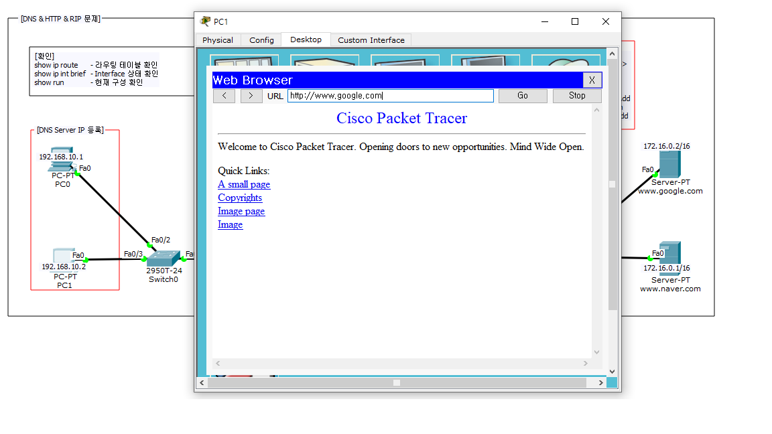
PC1 DNS

